Slide 1
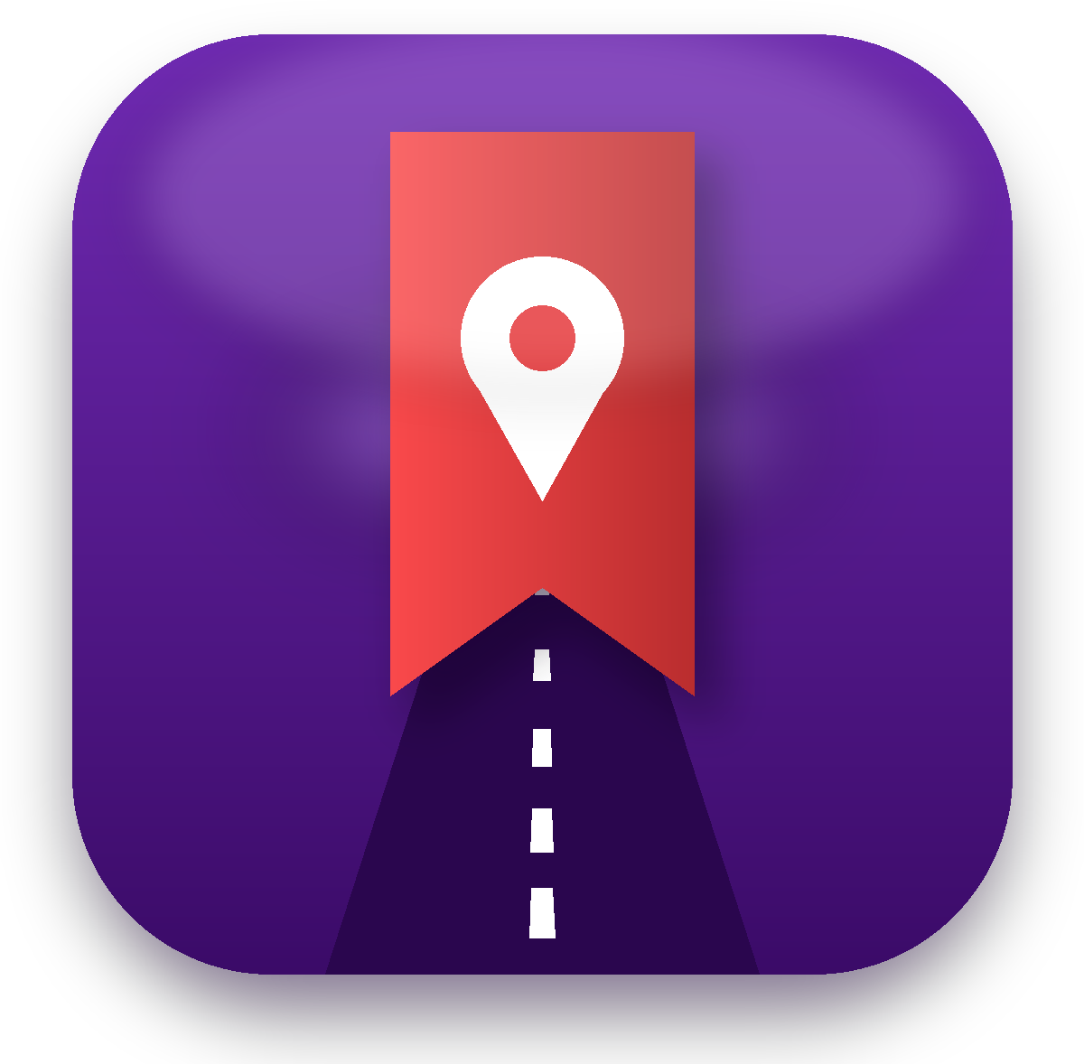
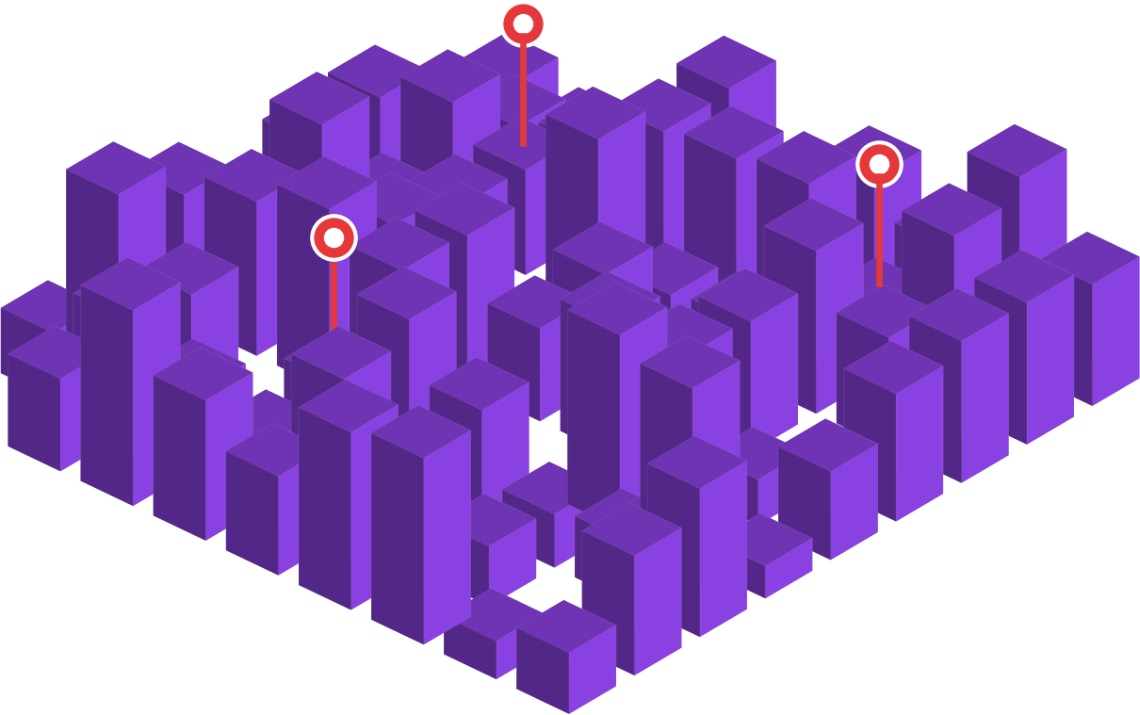
Your next customers already saved you.
Spotted turns Instagram saves into people walking through your door.
Start →
Notes:
Open with the hook. Then walk through the four simple steps.

Slide 2

STEP 1 OF 4
Someone sees your food in a reel.
They love it. It looks delicious.

Slide 3

STEP 2 OF 4
They tap save… and forget.
Saved posts get lost. The visit never happens.

Slide 4

STEP 3 OF 4
They walk near you. Spotted taps their phone: "You're close!"
A gentle reminder, only for places they saved.

Slide 5

STEP 4 OF 4
They come in. You scan. Everyone's happy.
And you see exactly how many came because of Spotted.
See how it helps you →

Slide 6






What's inside
Tap any card. The Menu button on every slide brings you back.
Why Spotted
Compared with delivery apps →
What you get
12 tools that bring guests in →
Pick your plan
From AED 99 a month →
What we need
Menu, offer, photos →
Payments
2 months free, then prepaid →
Questions
24 answers →

Slide 7

Keep your whole bill
Menu
Delivery apps
Spotted
Take about 20–35% of every order
Guests eat in. You keep the full bill.
One flat monthly plan from AED 99
AED 30,000 sales → AED 7,500–9,000 a month to the app
Plus drinks and desserts they order at your table.
Example: 300 delivery orders of AED 100. Commission rates from UAE industry reports; check your own contract.

Slide 8










12 ways Spotted brings guests in
Menu
Nearby reminders
Your own coupons
Stamp cards
Quiet-hours deals
People who saved you get a gentle nudge when they're close
You choose the offer, days and hours
Every plan: basic card; Grow and up: several rewards
Offers that switch on by themselves at slow times
Birthday treats
Real reviews
New-menu alerts
Ramadan mode
A free dessert or drink brings birthday crowds
"Visited with Spotted" stars come only from real, scanned visits
Tell people who saved you about a new dish
Iftar and suhoor guide with your seasonal offers
Creator picks
Weekly WhatsApp update
Reels + budget filter
Monthly report
Creators' followers save you in one tap
Your offer in Spotted's weekly message (opt-in users)
"Arabic food, AED 100 for two" shows your reel
Saves, people nearby, visits and repeat visits

Slide 9



3 stars show what really happened
Menu
Yellow star
Purple star
Green star
Saved your place but hasn't visited yet
Visited, but didn't buy anything
Visited and bought something
How: Purple: the customer scans the QR sticker at your door. Green: your staff scan their coupon or loyalty card at the till. Creators only see yellow and green: any visit counts as green for them.

Slide 10





Which one are you?
Menu
Tap your type to see your plan.
Cafeteria
AED 99/mo · 1 offer →
Café & bakery
AED 149/mo · 3 offers →
Single cuisine
AED 199/mo · 5 offers →
Multi-cuisine
AED 249/mo · Unlimited →
Multi-branch
AED 349/mo · Unlimited →
Hotel buffet
Custom deal →

Slide 11
Cafeteria
Menu
PLAN: STARTER
Includes:
Cafeterias and small snack counters
Listing with menu, photos and videos
Nearby reminders to people who saved you
1 active offer
Basic stamp card (one reward)
Visit scanning and basic report
AED 99 /month
1 active offer. Or AED 1,089 a year (pay 11 months, get 12).
Example: A small cafeteria: free karak with any sandwich 3-5pm, 6th karak free. Owner sees 120 saves and 45 visits a month.
First 2 months free
← All plans
Start free →

Slide 12
Café & bakery
Menu
PLAN: GROW
Everything in Starter, plus:
Cafés, bakeries, coffee shops and sweet shops, usually known for one special drink or sweet
Up to 3 active offers
Advanced stamp card (several rewards)
Quiet-hours deals that switch on by themselves
Birthday treats
New-menu alerts
AED 149 /month
3 active offers. Or AED 1,639 a year (pay 11 months, get 12).
Example: A coffee shop: half-price 2nd coffee before 11am, free cookie 3-5pm, 30% off pastries last hour; 5th coffee free upsize, 10th free.
First 2 months free
← All plans
Start free →

Slide 13
Single cuisine
Menu
PLAN: MAIN
Everything in Grow, plus:
Restaurants serving one cuisine, like just Pakistani or just Arabic
Up to 5 active offers
Creator picks (see which creators bring guests)
Star reviews from real visits
Dietary and family badges + Ramadan mode
Detailed report (busy times, repeat guests)
AED 199 /month
5 active offers. Or AED 2,189 a year (pay 11 months, get 12).
Example: A Pakistani restaurant: 5 offers incl. kids eat free 3-6pm; a creator's biryani reel brings 30 visits; report shows Friday 8pm is busiest.
First 2 months free
← All plans
Start free →

Slide 14
Multi-cuisine
Menu
PLAN: PREMIUM
Everything in Main, plus:
Restaurants serving many cuisines on one menu
Unlimited active offers
Featured at the top of your area's search
Offer in the weekly WhatsApp update (monthly)
Reels in budget search ("Indian food, AED 150 for two")
Spotted Passport listing
AED 249 /month
Unlimited offers. Or AED 2,739 a year (pay 11 months, get 12).
Example: A multi-cuisine family restaurant: a deal per cuisine, featured first in Khalifa City searches, in the WhatsApp update once a month.
First 2 months free
← All plans
Start free →

Slide 15
Multi-branch
Menu
PLAN: MULTI-BRANCH
Everything in Premium, plus:
Any café or restaurant with more than one branch in the UAE. Covers up to 3 branches, then AED 79 for each extra branch
Unlimited offers at every branch
One dashboard for all branches
Report for each branch
Brand page + stamps that count at every branch
Priority support
AED 349 /month
Unlimited offers at every branch. Up to 3 branches; +AED 79 per extra branch. Or AED 3,839 a year (pay 11 months, get 12).
Example: A café chain with 3 branches (a 4th adds AED 79): one offer everywhere, an extra deal only at the quiet branch, one dashboard.
First 2 months free
← All plans
Start free →

Slide 16
Hotels: made for buffets
Menu
75%
Custom deals, agreed with our team
25% off the bill
Buy one, get one free
Group and family offers
Seasonal buffets (Ramadan, holidays)
of hotel restaurant guests come for the buffet. We put your buffet in front of people who saved you.
Send us: a reel of your buffet items, how the buffet menu changes each day, your à la carte menu, and the deal you'd like. We'll build your page with you.
← All plans

Slide 17


What we need from you
Menu
Your full menu
With prices, so customers know what to expect
Your offer
A coupon, quiet-hours deal, free item or stamp-card reward
Menu photos or video
Clear, bright pictures of your best dishes
Buffet reel (if you have a buffet)
A short video of the buffet items, and how the buffet menu changes each day
A short description
Who you are and which category fits you: cafeteria, café, single cuisine, multi-cuisine, hotel buffet

Slide 18

Simple payments, no surprises
Menu
2 months free
Then prepaid
Payment issue?
After 60 days
Try everything first
Monthly, or yearly: pay 11 months, get 12
Fully active for 60 more days
Profile hidden. Content kept safe
After 60 days: your profile is hidden from customers and you can't see your content or receive stars, but everything is kept safe. Customers who saved you can still see your location. Pay anytime and it all comes back.

Slide 19
"But we already…"
Menu
"We're already busy."
"We're on delivery apps."
Great. Use Spotted only for your quiet hours, and fill tables that are empty anyway.
Spotted brings dine-in customers, with no commission on their bill.
"We already pay influencers."
"Discounts hurt us."
People saved that reel. Spotted reminds them when they're nearby, so the money you spent keeps working.
Use a free item or a quiet-hours deal. You choose.

Slide 20
Starting in Khalifa City
Menu
Launching first in Khalifa City, Abu Dhabi
Families, cafés and restaurants close together
Founding partners get featured first
We'll show you real numbers from your area

Slide 21
Your questions, answered
Menu
Tap a topic to see the answers.
4
4
4
Payments
How much does it cost? →
If a payment fails
What if my payment fails? →
Results
How do we know it works? →
4
4
4
Coupons & offers
Do we have to give a discount? →
Content & data
What do you need from us? →
Branches, hotels & more
We have 5 branches. What do we pay? →

Slide 22
Payments
Menu
How much does it cost?
Is there a free trial?
By type: Starter AED 99 (1 offer), Grow AED 149 (3 offers), Main AED 199 (5 offers), Premium AED 249 (unlimited), Multi-branch AED 349 (up to 3 branches, +AED 79 each extra). Free listing always available.
Yes. Your first 2 months are free, with everything in your plan.
How do I pay?
Is there a yearly deal?
Prepaid, monthly or yearly, by card or bank transfer.
Yes. Pay for 11 months and get 12.
← All questions
Next topic →

Slide 23
If a payment fails
Menu
What if my payment fails?
What happens after 60 days?
Nothing stops straight away. Your account stays fully active for 60 days so you can sort it out.
Your profile is hidden from customers. Your content stays safe, but you can't see it or receive stars.
Can customers still find us?
Can we come back?
Customers who already saved you can still see your location. Nothing else is visible until you pay.
Yes. Pay, and everything switches back on.
← All questions
Next topic →

Slide 24
Results
Menu
How do we know it works?
Who sees our offer?
Every coupon and stamp is scanned at your counter, and you get a monthly report.
People who saved you first, then people nearby looking for offers.
How do stars work?
Will you spam our customers?
Customers who visited and scanned can rate you. Only real visits count.
Never. Max 1 notification per area every 4-6 hours and 3 a day.
← All questions
Next topic →

Slide 25
Coupons & offers
Menu
Do we have to give a discount?
Can people cheat coupons?
No. A free item or quiet-hours deal works well.
No. One-time codes, limits and expiry dates.
Can we change our offer?
How do staff scan?
Yes, anytime, and pause it whenever you like.
One tap on a phone or tablet. It takes 30 seconds to learn.
← All questions
Next topic →

Slide 26
Content & data
Menu
What do you need from us?
Who makes the content?
Your menu, your offer, menu photos or video, a buffet reel if you have one, and a short description.
You send photos and videos; we set up your page with you. Creators may feature you too.
Can creators promote us?
Is customer data private?
Yes. Creator picks, and brand deals booked through Spotted.
Yes. Locations stay on customers' phones. You see totals, not personal details.
← All questions
Next topic →

Slide 27
Branches, hotels & more
Menu
We have 5 branches. What do we pay?
We're a hotel with buffets.
AED 349 covers 3 branches, plus AED 79 for each extra: AED 507 a month.
Our team agrees a custom deal with you: 25% off, buy one get one free, and more.
How is this different from delivery apps?
Can we cancel?
Delivery apps take up to a third of each order. Spotted brings dine-in guests for a flat monthly fee.
Yes. No long contracts. Monthly plans stop at the end of the paid month; yearly plans at the end of the year.
← All questions

Slide 28




Be a founding partner
Menu
Founding price locked for 12 months
Featured in launch week
"Founding partner" badge in the app
We set up your page with you, free
Limited to the first 20 partners in Khalifa City.

Slide 29
Start your 2 free months today
1
Pick your plan
2
Send your menu, offer and photos
3
We set up your page. Guests start coming
WhatsApp +971 50 873 3160
Back to menu

